Slide 1
Techniques Based on Recursion
Lecturer: Kai Wu
Email: kwu@xidian.edu.cn

Slide 2
What’s Recursion?
Recursion is the process of dividing the problem into one or more subproblems, which are identical in structure to the original problem and then combining the solutions to these subproblems to obtain the solution to the original problem.

Slide 3
What’s Recursion?
There are three special cases of the recursion technique:
Induction: the idea of induction in mathematical proofs is carried over to the design of efficient algorithms
Nonoverlapping subproblems: divide and conquer
Overlapping subproblems: dynamic programming, trading space for time

Slide 4
Induction
Given a problem with parameter n, designing an algorithm by induction is based on the fact that if we know how to solve the problem when presented with a parameter less than n, called the induction hypothesis, then our task reduces to extending that solution to include those instances with parameter n.

Slide 5
Radix Sort
Let L={a₁, a₂, …, a_{n}} be a list of n numbers each consisting of exactly k digits. That is, each number is of the form d_{k}d_{k-1}…d₁, where each d_{i} is a digit between 0 and 9.
In this problem, instead of applying induction on n, the number of objects, we use induction on k, the size of each integer.

Slide 6
Radix Sort
If the numbers are first distributed into the lists by their least significant digit, then a very efficient algorithm results.
Suppose that the numbers are sorted lexicographically according to their least k-1 digits, i.e., digits d_{k-1}, d_{k-2}, …, d₁.
After sorting them on their kth digits, they will eventually be sorted.

Slide 7
Radix Sort
First, distribute the numbers into 10 lists L₀, L₁, …, L₉ according to digit d₁ so that those numbers with d₁=0 constitute list L₀, those with d₁=1 constitute list L₁ and so on.
Next, the lists are coalesced in the order L₀, L₁, …, L₉.
Then, they are distributed into 10 lists according to digit d₂, coalesced in order, and so on.
After distributing them according to d_{k} and collecting them in order, all numbers will be sorted.

Slide 8
Radix Sort
Example: Sort A nondecreasingly.
A[1…5]=7467 3275 6792 9134 1239

Slide 9
Radix Sort
Input: A linked list of numbers L={a₁, a₂, …, a_{n}} and k, the number of digits.
Output: L sorted in nondecreasing order.
1. for j←1 to k
2. Prepare 10 empty lists L₀, L₁, …, L_{9;}
3. while L is not empty
4. a←next element in L;
5. Delete a from L;
6. i←jth digit in a;
7. Append a to list L_{i};
8. end while;
9. L ←L_{0;}
10. for i ←1 to 9
11. L←L, L_{i} //Append list L_{i} to L
12. end for;
13. end for;
14. return L;

Slide 10
Radix Sort
What’s the performance of the algorithm Radix Sort?
Time Complexity?
Space Complexity?

Slide 11
Radix Sort
Time Complexity: Θ(n)
Space Complexity: Θ(n)

Slide 12
Generating Permutations
Generating all permutations of the numbers 1, 2, …, n.
Based on the assumption that if we can generate all the permutations of n-1 numbers, then we can get algorithms for generating all the permutations of n numbers.

Slide 13
Generating Permutations
Generate all the permutations of the numbers 2, 3, …, n and add the number 1 to the beginning of each permutation.
Generate all permutations of the numbers 1, 3, 4, …, n and add the number 2 to the beginning of each permutation.
Repeat this procedure until finally the permutations of 1, 2, …, n-1 are generated and the number n is added at the beginning of each permutation.

Slide 14
Input: A positive integer n;
Output: All permutations of the numbers 1, 2, …, n;
1. for j←1 to n
2. P[j]←j;
3. end for;
4. perm(1);
perm(m)
1. if m=n then output P[1…n]
2. else
3. for j←m to n
4. interchange P[j] and P[m];
//Add one number at the beginning of the permutation
5. perm(m+1);
//Generate permutations for the left numbers
6. interchange P[j] and P[m];
7. end for;
8. end if;

Slide 15
Generating Permutations
What’s the performance of the algorithm Generating Permutations?
Time Complexity?
Space Complexity?

Slide 16
Generating Permutations
Time Complexity: Θ(nn!)
Space Complexity: Θ(n)

Slide 17
Finding the Majority Element
Let A[1…n] be a sequence of integers. An integer a in A is called the majority if it appears more than ⎣n/2⎦ times in A.
For example:
Sequence 1, 3, 2, 3, 3, 4, 3: 3 is the majority element since 3 appears 4 times which is more than ⎣n/2⎦
Sequence 1, 3, 2, 3, 3, 4: 3 is not the majority element since 3 appears three times which is equal to ⎣n/2⎦, but not more than ⎣n/2⎦

Slide 18
Finding the Majority Element
If two different elements in the original sequence are removed, then the majority in the original sequence remains the majority in the new sequence.
The above observation suggests the following procedure for finding an element that is candidate for being the majority.

Slide 19
Finding the Majority Element
Let x=A[1] and set a counter to 1.
Starting from A[2], scan the elements one by one increasing the counter by one if the current element is equal to x and decreasing the counter by one if the current element is not equal to x.
If all the elements have been scanned and the counter is greater than zero, then return x as the candidate.
If the counter becomes 0 when comparing x with A[j], 1<j<n, then call procedure candidate recursively on the elements A[j+1…n].

Slide 20
Finding the Majority Element
Why just return x as a candidate?
Restart
Count=1
4 4 4 1 2 3 5
Count=0
But 5 is not the majority element.

Slide 21
Input: An array A[1…n] of n elements;
Output: The majority element if it exists; otherwise none;
1. x←candidate(1);
2. count←0;
3. for j←1 to n
4. if A[j]=x then count←count+1;
5. end for;
6. if count>⎣n/2⎦ then return x;
7. else return none;
candidate(m)
1. j←m; x←A[m]; count←1;
2. while j<n and count>0
3. j ←j+1;
4. if A[j]=x then count ←count+1;
5. else count ←count-1;
6. end while;
7. if j=n then return x;
8. else return candidate(j+1);

Slide 22
Divide and Conquer
A divide-and-conquer algorithm divides the problem instance into a number of subinstances (in most cases 2), recursively solves each subinsance separately, and then combines the solutions to the subinstances to obtain the solution to the original problem instance.

Slide 23
Divide and Conquer
Consider the problem of finding both the minimum and maximum in an array of integers A[1…n] and assume for simplicity that n is a power of 2.
Divide the input array into two halves A[1…n/2] and A[(n/2)+1…n], find the minimum and maximum in each half and return the minimum of the two minima and the maximum of the two maxima.

Slide 24
Divide and Conquer
Input: An array A[1…n] of n integers, where n is a power of 2;
Output: (x, y): the minimum and maximum integers in A;
1. minmax(1, n);
minmax(low, high)
1. if high-low=1 then
2. if A[low]<A[high] then return (A[low], A[high]);
3. else return(A[high], A[low]);
4. end if;
5. else
6. mid←⎣(low+high)/2⎦;
7. (x₁, y₁)←minmax(low, mid);
8. (x₂, y₂)←minmax(mid+1, high);
9. x←min{x₁, x₂};
10. y ←max{y₁, y₂};
11. return(x, y);
12. end if;

Slide 25
Divide and Conquer
How many comparisons does this algorithm need?

Slide 26
Divide and Conquer
Given an array A[1…n] of n elements, where n is a power of 2, it is possible to find both the minimum and maximum of the elements in A using only (3n/2)-2 element comparisons.

Slide 27
The Divide and Conquer Paradigm
The divide step: the input is partitioned into p≥1 parts, each of size strictly less than n.
The conquer step: performing p recursive call(s) if the problem size is greater than some predefined threshold n₀.
The combine step: the solutions to the p recursive call(s) are combined to obtain the desired output.

Slide 28
The Divide and Conquer Paradigm
(1) If the size of the instance I is “small”, then solve the problem using a straightforward method and return the answer. Otherwise, continue to the next step;
(2) Divide the instance I into p subinstances I₁, I₂, …, I_{p} of approximately the same size;
(3) Recursively call the algorithm on each subinstance I_{j}, 1≤j≤p, to obtain p partial solutions;
(4) Combine the results of the p partial solutions to obtain the solution to the original instance I. Return the solution of instance I.

Slide 29
Selection: Finding the Median and the kth Smallest Element
The media of a sequence of n sorted numbers A[1…n] is the “middle” element.
If n is odd, then the middle element is the (n+1)/2th element in the sequence.
If n is even, then there are two middle elements occurring at positions n/2 and n/2+1. In this case, we will choose the n/2th smallest element.
Thus, in both cases, the median is the ⎡n/2⎤th smallest element.
The kth smallest element is a general case.

Slide 30
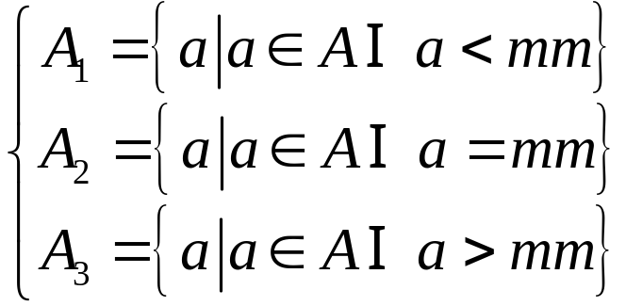
Selection: Finding the Median and the kth Smallest Element
If we select an element mm among A, then A can be divided in to 3 parts:

Slide 31
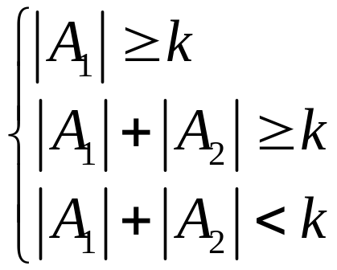
Selection: Finding the Median and the kth Smallest Element
According to the number elements in A₁, A₂, A₃, there are following three cases. In each case, where is the kth smallest element?

Slide 32
Selection: Finding the Median and the kth Smallest Element
Input: An array A[1…n] of n elements and an integer k, 1≤k≤n;
Output: The kth smallest element in A;
1. select(A, 1, n, k);

Slide 33
Selection: Finding the Median and the kth Smallest Element
select(A, low, high, k)
1. p←high-low+1;
2. if p<44 then sort A and return (A[k]);
3. Let q=⎣p/5⎦. Divide A into q groups of 5 elements each.
If 5 does not divide p, then discard the remaining elements;
4. Sort each of the q groups individually and extract its media.
Let the set of medians be M.
5. mm←select(M, 1, q, ⎡q/2⎤);
6. Partition A[low…high] into three arrays:
A₁={a|a<mm}, A₂={a|a=mm}, A₃={a|a>mm};
7. case
|A₁|≥k: return select (A₁, 1, |A₁|, k);
|A₁|+|A₂|≥k: return mm;
|A₁|+|A₂|<k: return select(A₃, 1, |A₃|, k-|A₁|-|A₂|);
8. end case;

Slide 34
Selection: Finding the Median and the kth Smallest Element
What is the time complexity of this algorithm?

Slide 35
Selection: Finding the Median and the kth Smallest Element
The kth smallest element in a set of n elements drawn from a linearly ordered set can be found in Θ(n) time.

Slide 36
Quicksort
Let A[low…high] be an array of n numbers, and x=A[low].
We consider the problem of rearranging the elements in A so that all elements less than or equal to x precede x which in turn precedes all elements greater than x.
After permuting the element in the array, x will be A[w] for some w, low≤w≤high. The action of rearrangement is also called splitting or partitioning around x, which is called the pivot or splitting element.

Slide 37
Quicksort
We say that an element A[j] is in its proper position or correct position if it is neither smaller than the elements in A[low…j-1] nor larger than the elements in A[j+1…high].
After partitioning an array A using x∈A as a pivot, x will be in its correct position.

Slide 38
Quicksort
Input: An array of elements A[low…high];
Output: (1) A with its elements rearranged, if necessary;
(2) w, the new position of the splitting element A[low];
1. i←low;
2. x←A[low];
3. for j←low+1 to high
4. if A[j]≤x then
5. i←i+1;
6. if i≠j then interchange A[i] and A[j];
7. end if;
8. end for;
9. interchange A[low] and A[i];
10.w←i;
11.return A and w;

Slide 39
Quicksort
The number of element comparisons performed by Algorithm SPLIT is exactly n-1. Thus, its time complexity is Θ(n).
The only extra space used is that needed to hold its local variables. Therefore, the space complexity is Θ(1).

Slide 40
Quicksort
Input: An array A[1…n] of n elements;
Output: The elements in A sorted in nondecreasing order;
1. quicksort(A, 1, n);
quicksort(A, low, high)
1. if low<high then
2. SPLIT(A[low…high], w) \\w is the new position of A[low];
3. quicksort(A, low, w-1);
4. quicksort(A, w+1, high);
5. end if;

Slide 41
Quicksort
The average number of comparisons performed by Algorithm QUICKSORT to sort an array of n elements is Θ(nlogn).

Slide 42
Dynamic Programming
An algorithm that employs the dynamic programming technique is not recursive by itself, but the underlying solution of the problem is usually stated in the form of a recursive function.
This technique resorts to evaluating the recurrence in a bottom-up manner, saving intermediate results that are used later on to compute the desired solution.
This technique applies to many combinatorial optimization problems to derive efficient algorithms.

Slide 43
Dynamic Programming
Fibonacci sequence:
f₁=1
f₂=1
f₃=2
f₄=3
f₅=5
f₆=8
f₇=13
……
f(n)
1. if (n=1) or (n=2) then return 1;
2. else return f(n-1)+f(n-2);
This algorithm is far from being efficient, as there are many duplicate recursive calls to the procedure.

Slide 44
Dynamic Programming
f(n)
1. if (n=1) or (n=2) then return 1;
2. else
3. {
4. fn_1=1;
5. fn_2=1;
6. for i←3 to n
7. fn=fn_1+fn_2;
8. fn_2=fn_1;
9. fn_1=fn;
10. end for;
11. }
12. Return fn;
Time: n-2 additions ⇒ θ(n)
Space: θ(1)

Slide 45
The Longest Common Subsequence Problem
Given two strings A and B of lengths n and m, respectively, over an alphabet ∑, determine the length of the longest subsequence that is common to both A and B.
A subsequence of A=a₁a₂…a_{n} is a string of the form a_{i1}a_{i2}…a_{ik}, where each i_{j} is between 1 and n and 1≤i₁<i₂<…<i_{k}≤n.

Slide 46
The Longest Common Subsequence Problem
Let A=a₁a₂…a_{n} and B=b₁b₂…b_{m}.
Let L[i, j] denote the length of a longest common subsequence of a₁a₂…a_{i} and b₁b₂…b_{j}. 0≤i≤n, 0≤j≤m. When i or j be 0, it means the corresponding string is empty.
Naturally, if i=0 or j=0; the L[i, j]=0

Slide 47
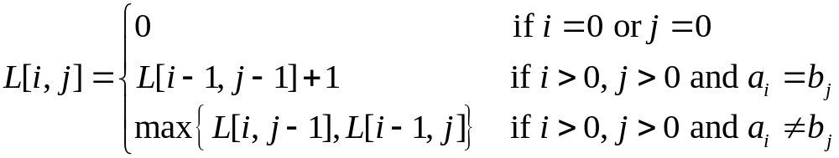
The Longest Common Subsequence Problem
Suppose that both i and j are greater than 0. Then
If a_{i}=b_{j}, L[i, j]=L[i-1, j-1]+1
If a_{i}≠b_{j}, L[i, j]=max{L[i, j-1], L[i-1, j]}
We get the following recurrence for computing the length of the longest common subsequence of A and B:

Slide 48
The Longest Common Subsequence Problem
We use an (n+1)×(m+1) table to compute the values of L[i, j] for each pair of values of i and j, 0≤i≤n, 0≤j≤m.
We only need to fill the table L[0…n, 0…m] row by row using the previous formula.

Slide 49
The Longest Common Subsequence Problem
Example: A=zxyxyz, B=xyyzx
What is the longest common subsequence of A and B?

Slide 50
The Longest Common Subsequence Problem
Input: Two strings A and B of lengths n and m, respectively, over an alphabet ∑;
Output: The length of the longest common subsequence of A and B.
1. for i←0 to n
2. L[i, 0]←0;
3. end for;
4. for j←0 to m
5. L[0, j]←0;
6. end for;
7. for i←1 to n
8. for j←1 to m
9. if a_{i}=b_{j} then L[i, j]←L[i-1, j-1]+1;
10. else L[i, j]←max{L[i, j-1], L[i-1, j]};
11. end if;
12. end for;
13. end for;
14. return L[n, m];

Slide 51
The Longest Common Subsequence Problem
What’s the performance of this algorithm?
Time Complexity?
Space Complexity?

Slide 52
The Longest Common Subsequence Problem
An optimal solution to the longest common subsequence problem can be found in Θ(nm) time and Θ(min{m, n}) space.

Slide 53
The Dynamic Programming Paradigm
The idea of saving solutions to subproblems in order to avoid their recomputation is the basis of this powerful method.
This is usually the case in many combinatorial optimization problems in which the solution can be expressed in the form of a recurrence whose direct solution causes subinstances to be computed more than once.

Slide 54
The Dynamic Programming Paradigm
An important observation about the working of dynamic programming is that the algorithm computes an optimal solution to every subinstance of the original instance considered by the algorithm.
This argument illustrates an important principle in algorithm design called the principle of optimality: Given an optimal sequence of decisions, each subsequence must be an optimal sequence of decisions by itself.

Slide 55

The All-Pairs Shortest Path Problem
Let G=(V, E) be a directed graph in which each edge (i, j) has a non-negative length l[i, j]. If there is no edge from vertex i to vertex j, then l[i, j]=∞.
The problem is to find the distance from each vertex to all other vertices, where the distance from vertex x to vertex y is the length of a shortest path from x to y.
For simplicity, we will assume that V={1, 2, …, n}. Let i and j be two different vertices in V. Define to be the length of a shortest path from i to j that does not pass through any vertex in {k+1, k+2, …, n}.

Slide 56




The All-Pairs Shortest Path Problem
is the length of a shortest path from i to j that does not pass through any vertex except possibly vertex 1
is the length of a shortest path from i to j that does not pass through any vertex except possibly vertex 1 or vertex 2 or both
is the length of a shortest path from i to j, i.e. the distance from i to j

Slide 57
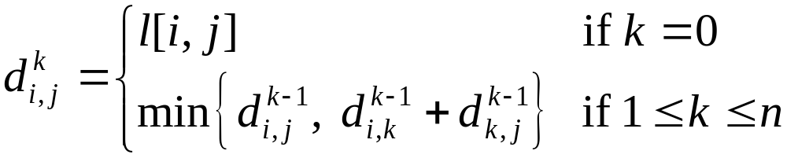
The All-Pairs Shortest Path Problem
We can compute recursively as follows:

Slide 58
The All-Pairs Shortest Path Problem
Floyd Algorithm: use n+1 matrices D₀, D₁, D₂, …, D_{n} of dimension n×n to compute the lengths of the shortest constrained paths.
Initially, we set D₀[i, i]=0, D₀[i, j]=l[i, j] if i≠j and (i, j) is an edge in G; otherwise D₀[i, j]=∞.
We then make n iterations such that after the kth iteration, D_{k}[i, j] contains the value of a shortest length path from vertex i to vertex j that does not pass through any vertex numbered higher than k.

Slide 59
The All-Pairs Shortest Path Problem
Thus, in the kth iteration, we compute D_{k}[i, j] using the formula
D_{k}[i, j]=min{D_{k-1}[i, j], D_{k-1}[i, k]+D_{k-1}[k, j]}

Slide 60
The All-Pairs Shortest Path Problem
Example:
1
2
1
8
9
2
3
6

Slide 61
The All-Pairs Shortest Path Problem
Input: An n×n matrix l[1…n, 1…n] such that l[i, j] is the length of the edge (i, j) in a directed graph G=({1, 2, …, n}, E);
Output: A matrix D with D[i, j]=the distance from i to j;
1. D←l;
2. for k←1 to n
3. for i←1 to n
4. for j←1 to n
5. D[i, j]=min{D[i, j], D[i, k]+D[k, j]);
6. end for;
7. end for;
8. end for;

Slide 62
The All-Pairs Shortest Path Problem
What is the time and space complexity of the FLOYD algorithm?

Slide 63
The All-Pairs Shortest Path Problem
The running time of FLOYD algorithm is Θ(n³) and its space complexity is Θ(n²).

Slide 64
The Knapsack Problem
Let U={u₁, u₂, …, u_{n}} be a set of n items to be packed in a knapsack of size C. for 1≤j≤n, let s_{j} and v_{j} be the size and value of the jth item, respectively, where C and s_{j}, v_{j}, 1≤j≤n, are all positive integers.
The objective is to fill the knapsack with some items for U whose total size is at most C and such that their total value is maximum. Assume without loss of generality that the size of each item does not exceed C.

Slide 65
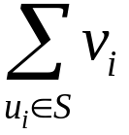
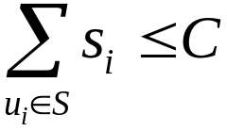
The Knapsack Problem
More formally, given U of n items, we want to find a subset S⊆U such that
is maximized subject to the constraint
This version of the knapsack problem is sometimes referred to in the literature as the 0/1 knapsack problem. This is because the knapsack cannot contain more than one item of the same type.

Slide 66
The Knapsack Problem
Let V[i, j] denote the value obtained by filling a knapsack of size j with items taken from the first i items {u₁, u₂, …, u_{i}} in an optimal way. Here the range of i is from 0 to n and the range of j is from 0 to C. Thus, what we seek is the value V[n, C].
Obviously, V[0, j] is 0 for all values of j, as there is nothing in the knapsack. On the other hand, V[i, 0] is 0 for all values of i since nothing can be put in a knapsack of size 0.

Slide 67
The Knapsack Problem
V[i, j], where i>0 and j>0, is the maximum of the following two quantities:
V[i-1, j]: The maximum value obtained by filling a knapsack of size j with items taken from {u₁, u₂, …, u_{i-1}} only in an optimal way.
V[i-1, j-s_{i}]+v_{i}: The maximum value obtained by filling a knapsack of size j-s_{i} with items taken from {u₁, u₂, …, u_{i-1}} in an optimal way plus the value of item u_{i}. This case applies only if j≥s_{i} and it amounts to adding item u_{i} to the knapsack.

Slide 68
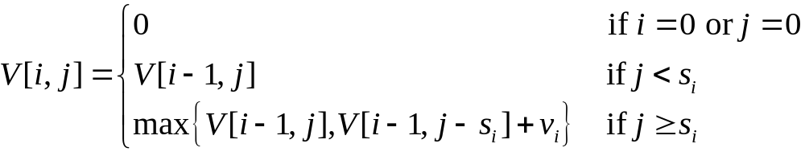
The Knapsack Problem
Then, we got the following recurrence for finding the value in an optimal packing:
Using dynamic programming to solve this integer programming problem is now straightforward. We use an (n+1)×(C+1) table to evaluate the values of V[i, j]. We only need to fill the table V[0…n, 0…C] row by row using the above formula.

Slide 69
The Knapsack Problem
Example:
C=9
U={u₁, u₂, u₃, u₄}
S_{i}=2, 3, 4, 5
V_{i}=3, 4, 5, 7

Slide 70


The Knapsack Problem
Input: A set of items U={u₁, u₂, …, u_{n}} with sizes s₁, s₂, …, s_{n} and values v₁, v₂, …, v_{n} and a knapsack capacity C.
Output: The maximum value of the function subject to for some subset of items S⊆U.
1. for i←0 to n
2. V[i, 0]←0;
3. end for;
4. for j←0 to C
5. V[0, j]←0;
6. end for;
7. for i←1 to n
8. for j←1 to C
9. V[i, j]←V[i-1, j];
10. if s_{i}≤j then V[i, j] ←max{V[i, j], V[i-1, j-s_{i}]+v_{i}};
11. end for;
12. end for;
13. return V[n, C];

Slide 71
The Knapsack Problem
What is the time and space complexity of this algorithm?

Slide 72
The Knapsack Problem
An optimal solution to the Knapsack problem can be found in Θ(nC) time and Θ(C) space.

